Slide 1
Mobile and Web Multimedia
CT081-3-3
Version VC1
Module Introduction & Overview

Slide 2
Lecturer Information
Lecturer Name: Daniel Mago Vistro
Email: daniel.mago@staffemail.apu.edu.my
Telephone Extension: -

Slide 3
Pre-requisites for this Module
Web Applications (CT050-3-2) or
Web Multimedia (CT051-3-2)

Slide 4
Aims of this Module
This module allows the student to understand the uses of multimedia and the web on mobile devices such as phones and PDAs.

Slide 5
Course Learning Outcomes, CLOs
At the end of this course, YOU should be able to:
Evaluate the emerging technologies and standards for mobile and web multimedia.
Construct appropriate mobile web and multimedia application.
Compare the current types of mobile multimedia today.

Slide 6
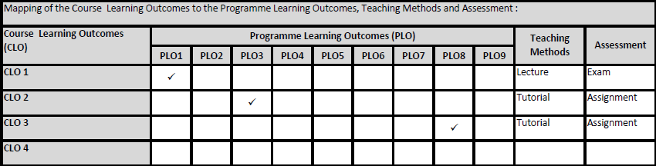
Mapping of CLOs with MOEs Domain
PLO1 – Knowledge
PLO3 – Thinking and Scientific Skills
PLO8 – Managerial and Entrepreneurial Skills

Slide 7
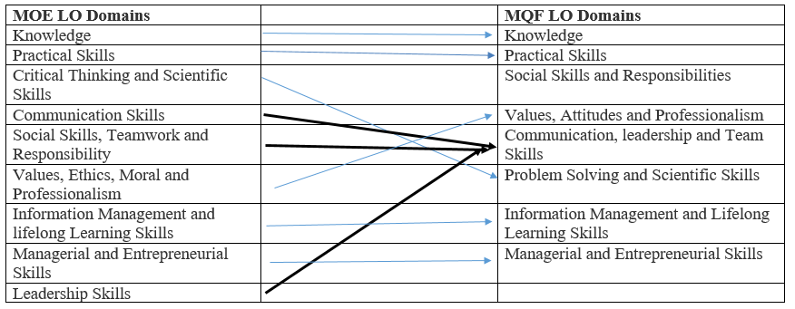
MQF and MOE Domains

Slide 8
Teaching Strategies
Lecture
Tutorial

Slide 9
Assessment Methods
Final Exam (50%) : CLO1
Individual Assignment (50%)
Design and execution of lab cases: CLO2
Regular update of progress: CLO3
**refer to SAIS for details

Slide 10
Student Learning Time (SLT)
Course Credit Value: 3
Total Learning Hours:
Lecture: 14 hours per semester
Tutorial / Case Study : 28 hours per semester
Independent Learning Time: 51 hours

Slide 11
Methods of Delivery
Hence,
We are now moving from the traditional topic based teaching to outcome-based education.

Slide 12
Outcomes Based Education (OBE)
OBE is education based on producing particular educational outcomes that:
Focus on what students can actually do after they are taught
Expect all learners / students to successfully achieve particular (sometimes minimum) level of knowledge and abilities.

Slide 13
So…What is OBE?
It’s
NOT
What we want to teach,
It’s
What You should learn

Slide 14
Course Content Outline
CLO1 : Final Exam (50%)
Lecture
Introduction to the different types of commercially available mobile applications
Mobile web development
Mobile multimedia
Mobile design
Mobile gaming
Mobile commerce
Mobile security
Mobile applications and Web 2

Slide 15
Course Content Outline
CLO2 & CLO3 : Individual Assignment (50%)
Tutorial
HTML5
CSS
ASP.NET
Database Connectivity
Review of current trends in Mobile & Web Multimedia

Slide 16
What is expected of you
You should abide to all the rules & regulation of APU:
Proper attire
No speaking of dialects
Attendance is compulsory and valid medical certificates or letters from parents /guardians must support any absence from class.
Three lateness will be equal to one absence
All pagers and hand phones should be turned off during lectures.

Slide 17
What support is available for you
Consultation hours
Resources
Reference material
Essential Reading
Frahaan Hussain (2017), Responsive web design by example : embrace responsive design with HTML5, CSS3, JavaScript, jQuery, and Bootstrap 4. Packt Publishing.
Mark J. Collins (2017), Pro HTML5 with CSS, JavaScript, and multimedia : complete website development and best practices. Apress.
Further Reading:
Godbold, A. and Jackson, S. (2016) Mastering Unity 2D Game Development. 2nd Ed. USA:Packt Publishing. ISBN: 1786463458.
Software : Visual Studio, SQL Server, PHP, MySQL

Slide 18
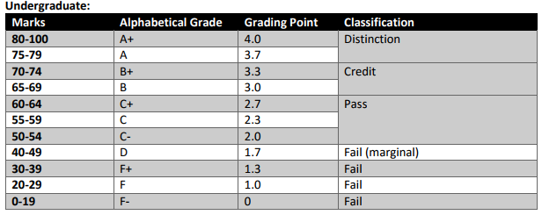
Achievement requirements

Slide 19
Question and Answer Session
Q & A

Slide 20
What we will cover next
Different Types of Commercially Available Mobile Applications

